Slide 1


Leveraging Data in Clinical Research: R Workshop & Clinical Trial Visualizations
Preston Burns
Notes:
Today is about getting feet wet and sharing like you’ve shared with me and taught me – sparking ideas, providing resources

Slide 2
Agenda
R statistical programming language workshop
Introduction and Installation of R
Workshop
Lunch
Visualizations in Clinical Research: A CRO Perspective

Slide 3
Agenda
R statistical programming language workshop
Introduction and Installation of R
Workshop
Lunch
Visualizations in Clinical Research: A CRO Perspective

Slide 4
About Me
Live in Hillsborough, NC, USA
Wife is training to be an OBGYN
Education:
B.S.P.H. in Biostatistics form University of North Carolina at Chapel Hill
M.S. in Analytics from NC State University
Currently Data Scientist at Rho, Inc. a Clinical Research Organization in Durham, NC

Slide 5

What is R?
A language and environment for statistical computing and graphics.
Descended from S language and environment which was developed at Bell Laboratories (formerly AT&T, now Lucent Technologies) by John Chambers and colleagues.
Open-source
Highly extensible
Popular language in data science and statistical analysis

Slide 6
Why R?
Open-source
Free
Extensible
Powerful data wrangling and data analysis functionality
State-of-the-ark statistical methods
Widely used in academia/life sciences/pharmaceuticals
Has been used in submissions to FDA
Life Science Companies/Universities moving towards R use
Large Community
Notes:
Roche, biostatistics programs, learning resources

Slide 7
How I’ve used R
Bioinformatics Research
SafetyGraphics App
Preparing financial data
Operational Study Dashboards (Similar Example¹)
Resourcing Dashboards
Text Mining
Many more!
Notes:
Everything I share today is open source – cant share confidential stuff –everything is my opinion etc not rhos

Slide 8
Download Workshop Materials
Navigate to https://github.com/pburnsdata/RWorkshop

Slide 9
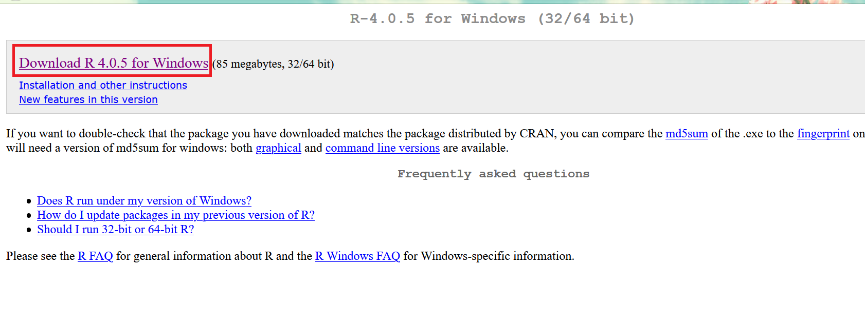
Installing R
Navigate to https://cran.r-project.org/bin/windows/base/

Slide 10
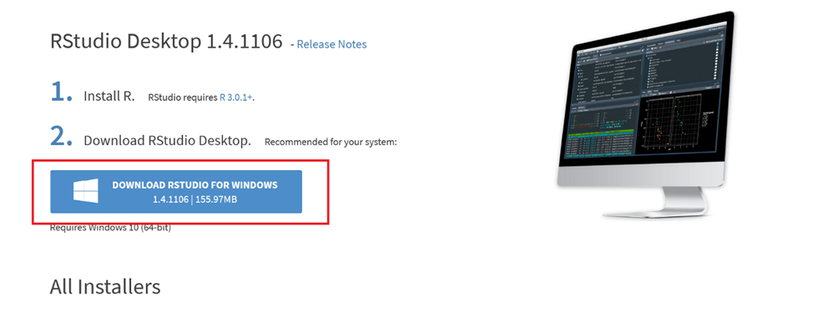
Installing Rstudio
Navigate to https://www.rstudio.com/products/rstudio/download/#download

Slide 11
Agenda
R statistical programming language workshop
Introduction and Installation of R
Workshop
Lunch
Visualizations in Clinical Research: A CRO Perspective

Slide 12

Start Workshop!

Slide 13
ggplot: The Grammar of Graphics
Notes:
Leland Wilkinson 2005 Professor of Computer Science

Slide 14
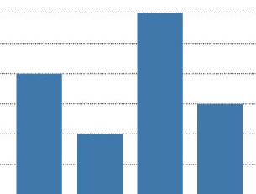

ggplot: Layer
Primary Components:
Data + aesthetic mapping
What variable is mapped to what part of the chart?
Count of cookies -> height of bars in bar chart
Geometric Object

Slide 15
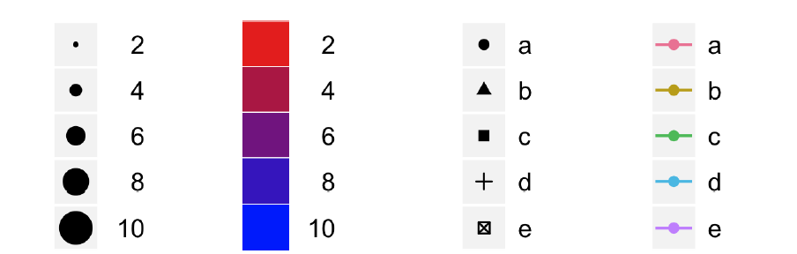
ggplot: Scale
A scale controls how data is mapped to aesthetics

Slide 16
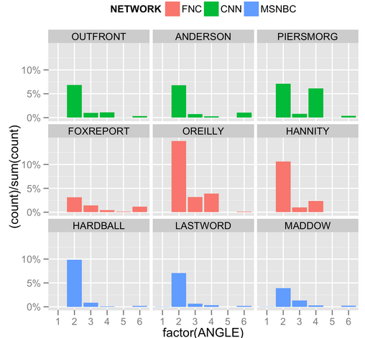
ggplot: Facets
Create small multiples of chart based on variable in data

Slide 17
Agenda
R statistical programming language workshop
Introduction and Installation of R
Workshop
Lunch
Visualizations in Clinical Research: A CRO Perspective

Slide 18
Agenda
R statistical programming language workshop
Introduction and Installation of R
Workshop
Lunch
Visualizations in Clinical Research: A CRO Perspective

Slide 19
Reference
All Visualizations presented here were developed at Rho, Inc. and are shared under open-source MIT license

Slide 20
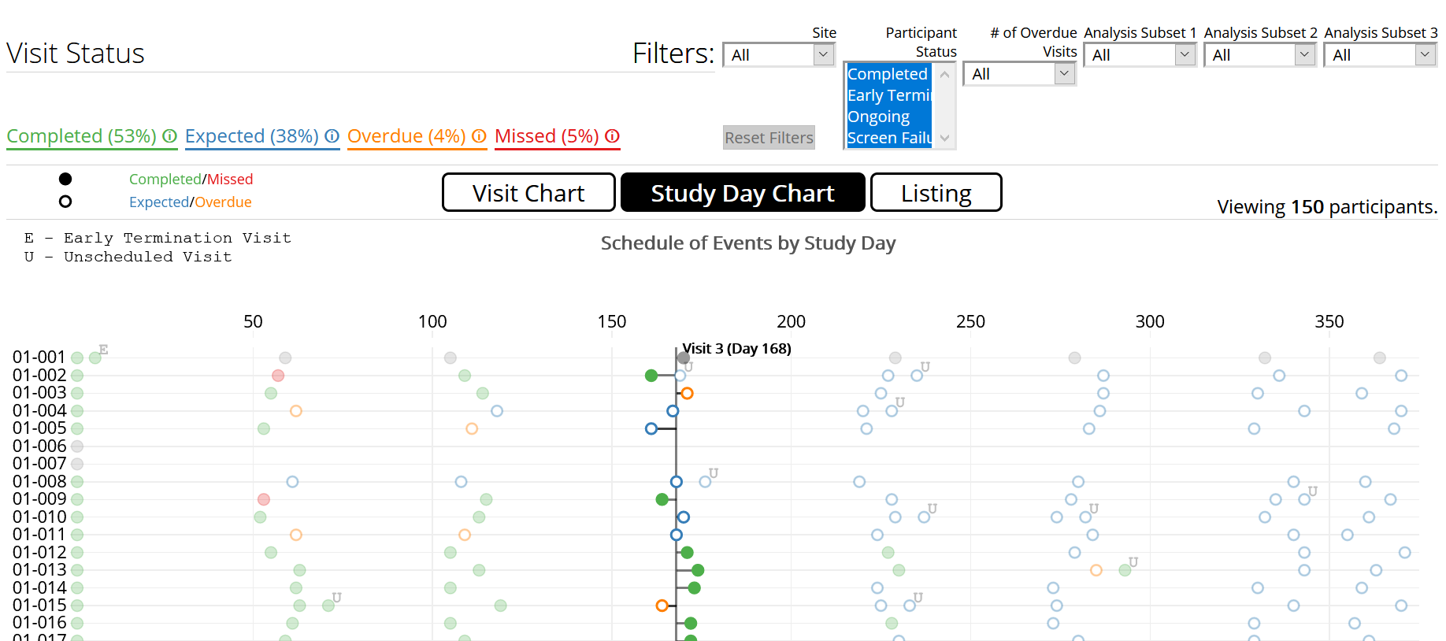
Participant Visit Listing
https://rhoinc.github.io/participant-visit-listing/test-page/

Slide 21
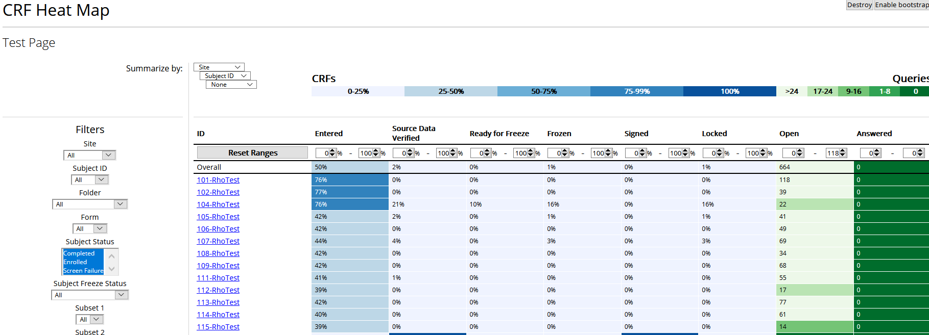
CRF Heat Map
https://rhoinc.github.io/crf-heat-map/test-page/

Slide 22
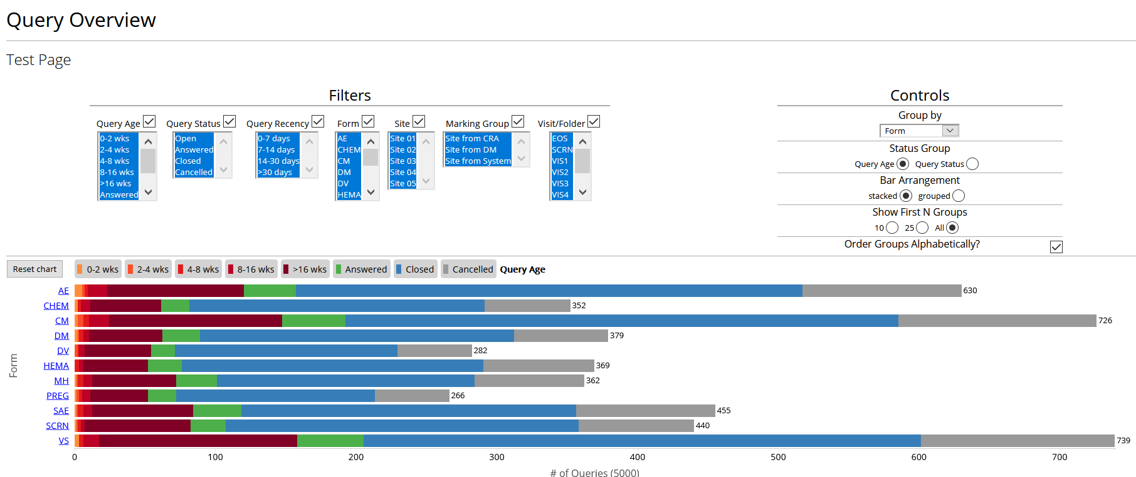
Query Overview
https://rhoinc.github.io/query-overview/test-page/

Slide 23
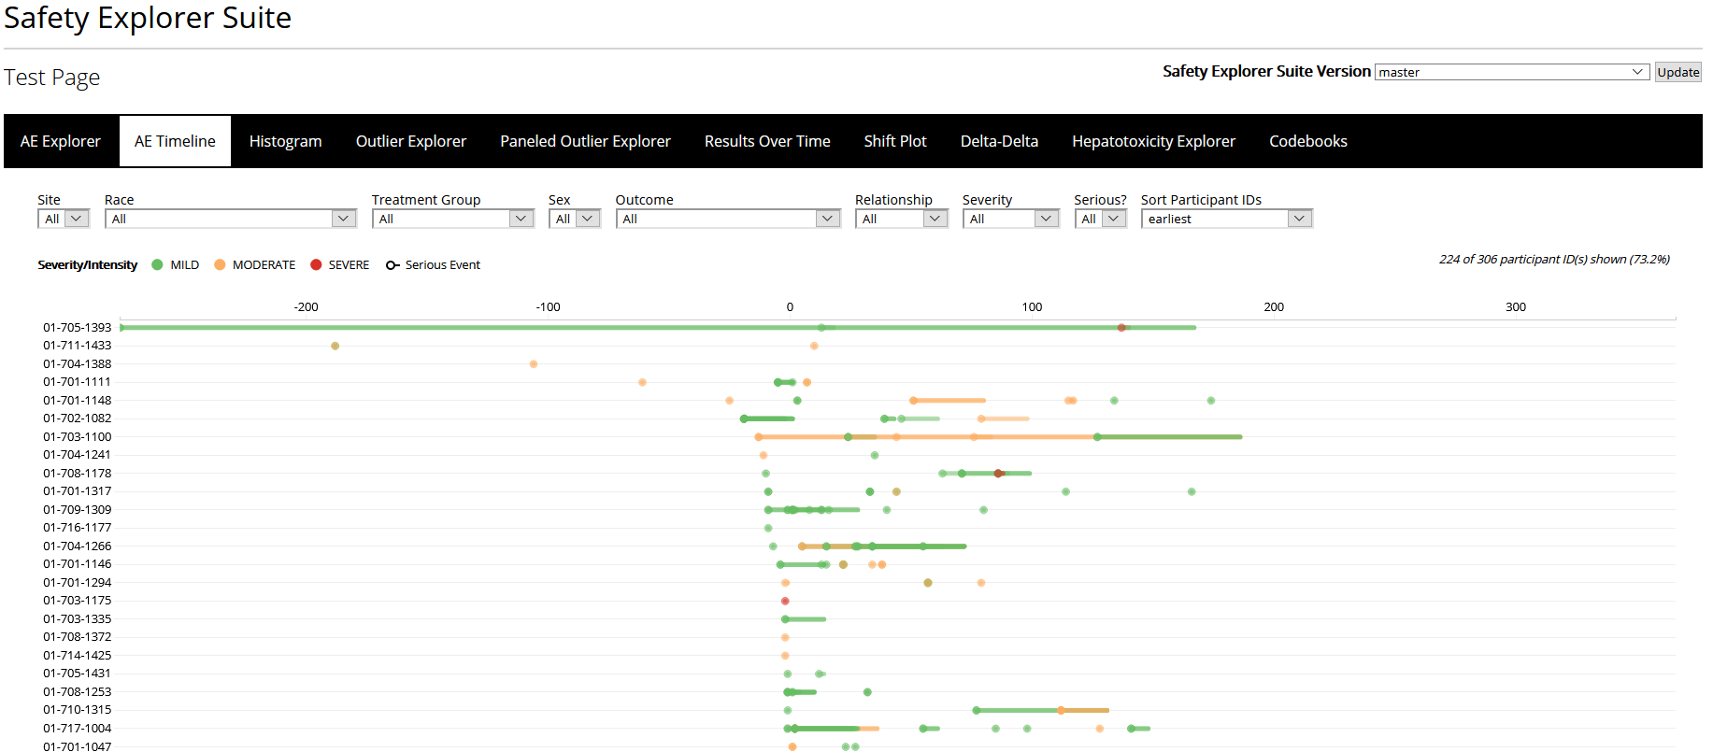
Safety Explorer Suite
https://rhoinc.github.io/safety-explorer-suite/test-page/

Slide 24
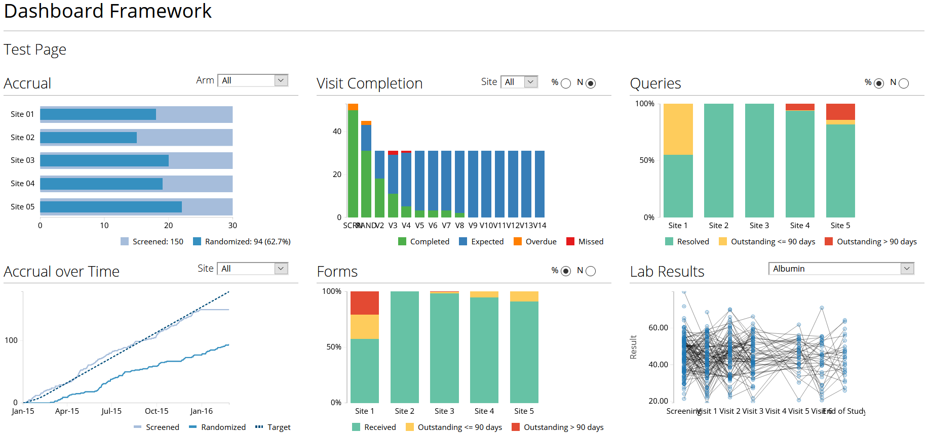
Operational Study Dashboards
https://rhoinc.github.io/dashboard-framework/test-page/

Slide 25
Resources for Learning R
Software Carpentry Training: R for Reproducible Scientific Analysis (Free)
https://education.rstudio.com/learn/beginner/ (Links to Free Material)
R for Data Science (Free ebook)
Datacamp (Limited Free courses, mostly paid trainings)

Slide 26

Thank You!

